Slide 1
Women in Film
Amal Alabdulkarim (aa4235)
Jing Qian (jq2282)

Slide 2
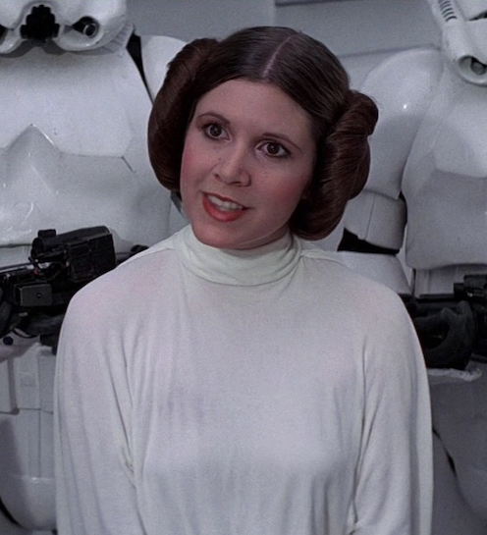
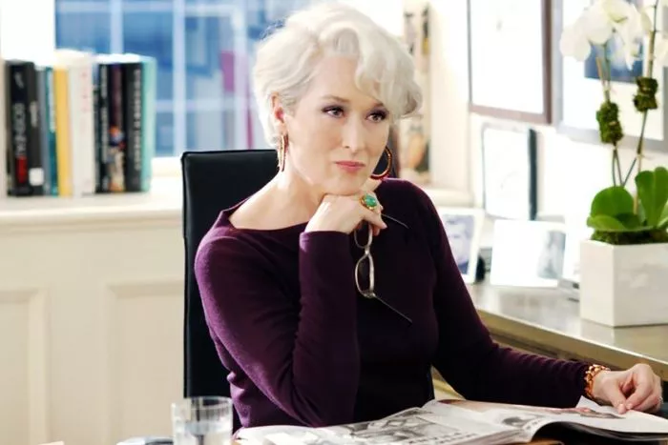
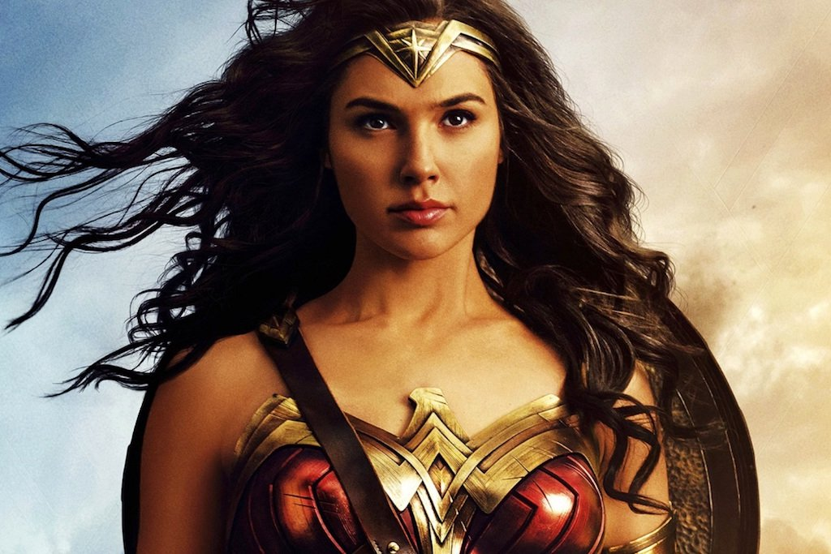
How movies portray female characters through time
Notes:
We wanted to see how the role of female characters changed with time and genre.
Previous studies: one or two sentences to show that this topics has been studied previously.
Female characters role in movies and change overtime
Main goal, two slides:
Comparison between two women characters in two years.
Across genres, (War, Romance, Drama, ...).

Slide 3
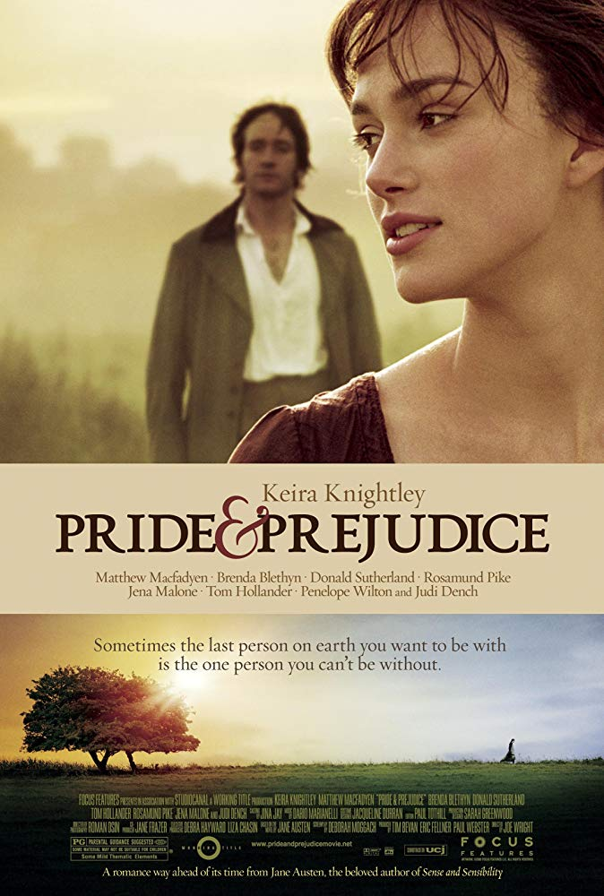
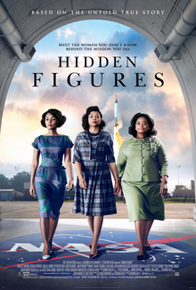
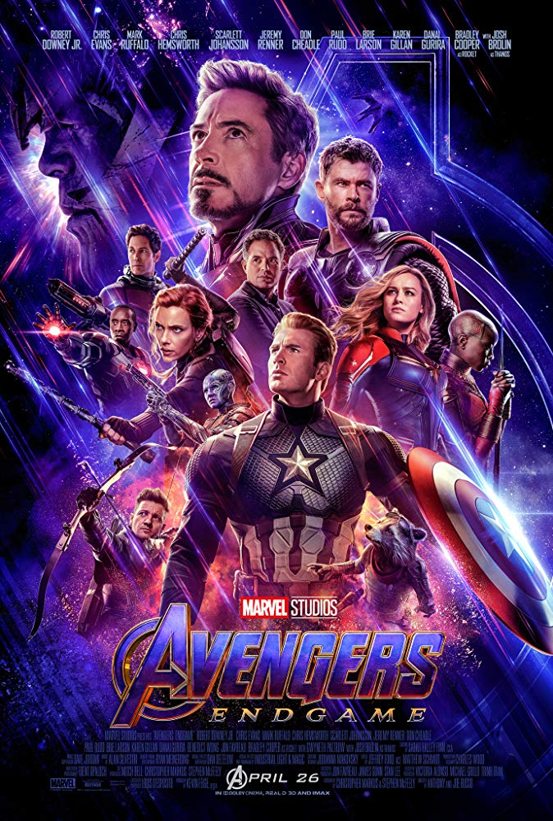
Understand how the female characters roles differ in different genre
Notes:
We wanted to see how the role of female characters changed with time and genre.
Previous studies: one or two sentences to show that this topics has been studied previously.

Slide 4
Data Exploration
Cornell Movie Dialogues dataset
Years | 1930 - 2009
Female Characters | 966
Male Characters | 2049
Number of lines | 242023
Number of Movies | 600
Notes:
Plot/Table to do data exploration.
30% lines by female characters.
70% lines by male characters.

Slide 5
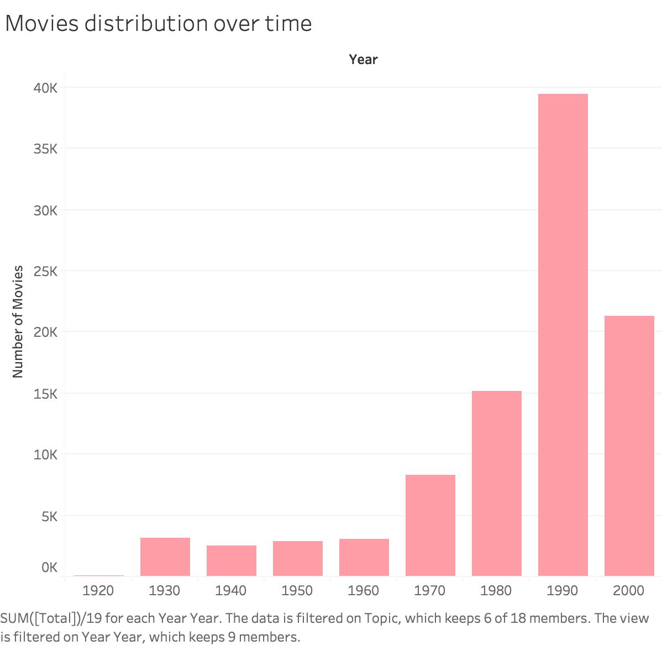
Data Exploration
Notes:
Plot/Table to do data exploration.

Slide 6
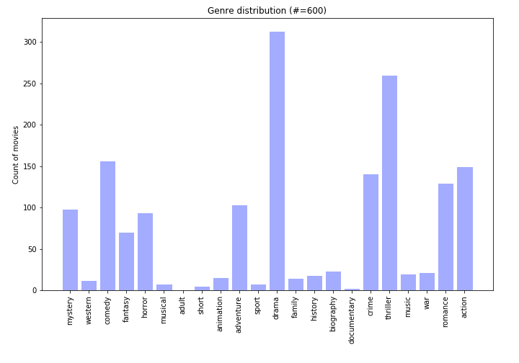
Data Exploration
Notes:
Plot/Table to do data exploration.
One movie is labeled with multiple

Slide 7
Hypo 1. Female characters dialogue topics became less men focused and more diverse in recent movies compared to older ones.
Diverse: The topics of women dialogues spans multiple topics and men aren’t the main topic of these conversations.
Notes:
Describe our hypothesis briefly.
The first aspect is when two female characters are talking to each other, they will be talking about something other than men.
How often would female characters talk about men?
Have the female dialogues topics changed overtime?

Slide 8
Q 1.1 How often would female characters talk about men?
Method: Use LIWC ‘Male Reference’ dimension to get the percentage of male references in each line in female characters conversations and then compare this percentage to the other dimensions.
We will use chi-square to measure if there is a relation between male references and the gender of the character.
Example of these words:
Male References: Pronouns (he, his, him), Nouns (male, man, boy, etc.)
Personal Concerns: cook, chat, majors, kitchen, job and cash.
Notes:
Describe our hypothesis briefly.
The first aspect is when two female characters are talking to each other, they will be talking about something other than men.
Calculate the ratio for the lines where the men reference dimension was the highest when compared to the personal concerns LIWC category.

Slide 9
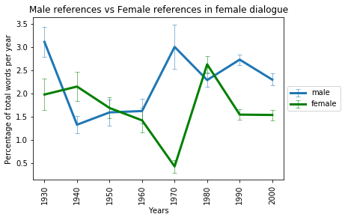
Results
Notes:
men references in the female-female conversation is very high in all the years, more than 77%.
This could be attributed to mentioning men in the context of other topics, for example.
In recent years we don’t see a clear trend in the change the of male references through time.
Male reference frequency didn’t improve with time.

Slide 10
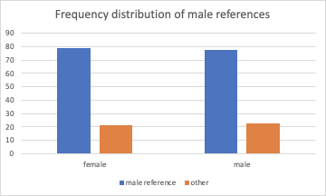
Results
Notes:
men references in the female-female conversation is very high in all the years, more than 77%.
This could be attributed to mentioning men in the context of other topics, for example.

Slide 11
Results
There is no clear trend in the frequency of male references through time.
There is an association between gender of characters in movies and the use of male references. (p-value <0.05)
Among female characters the likelihood of using male references in their dialogue is 1.02 times higher than male characters using male references in their dialogues.
Notes:
men references in the female-female conversation is very high in all the years, more than 77%.
This could be attributed to mentioning men in the context of other topics, for example.
1.0232
chi p-value = < 0.001

Slide 12
Q 1.2 How diverse are the female characters dialogues?
Latent Dirichlet allocation (LDA) with 18 topics.
We also wanted to understand the distribution of topics across the movies..
We trained the LDA model on the full dataset and then we used it to predict the topics of each movie line.
Notes:
The second aspect is whether the female character conversations span across different topics. Describe our hypothesis briefly. We did a cross validation to choose the correct topics size. We found out that 18 topics did very well.

Slide 13
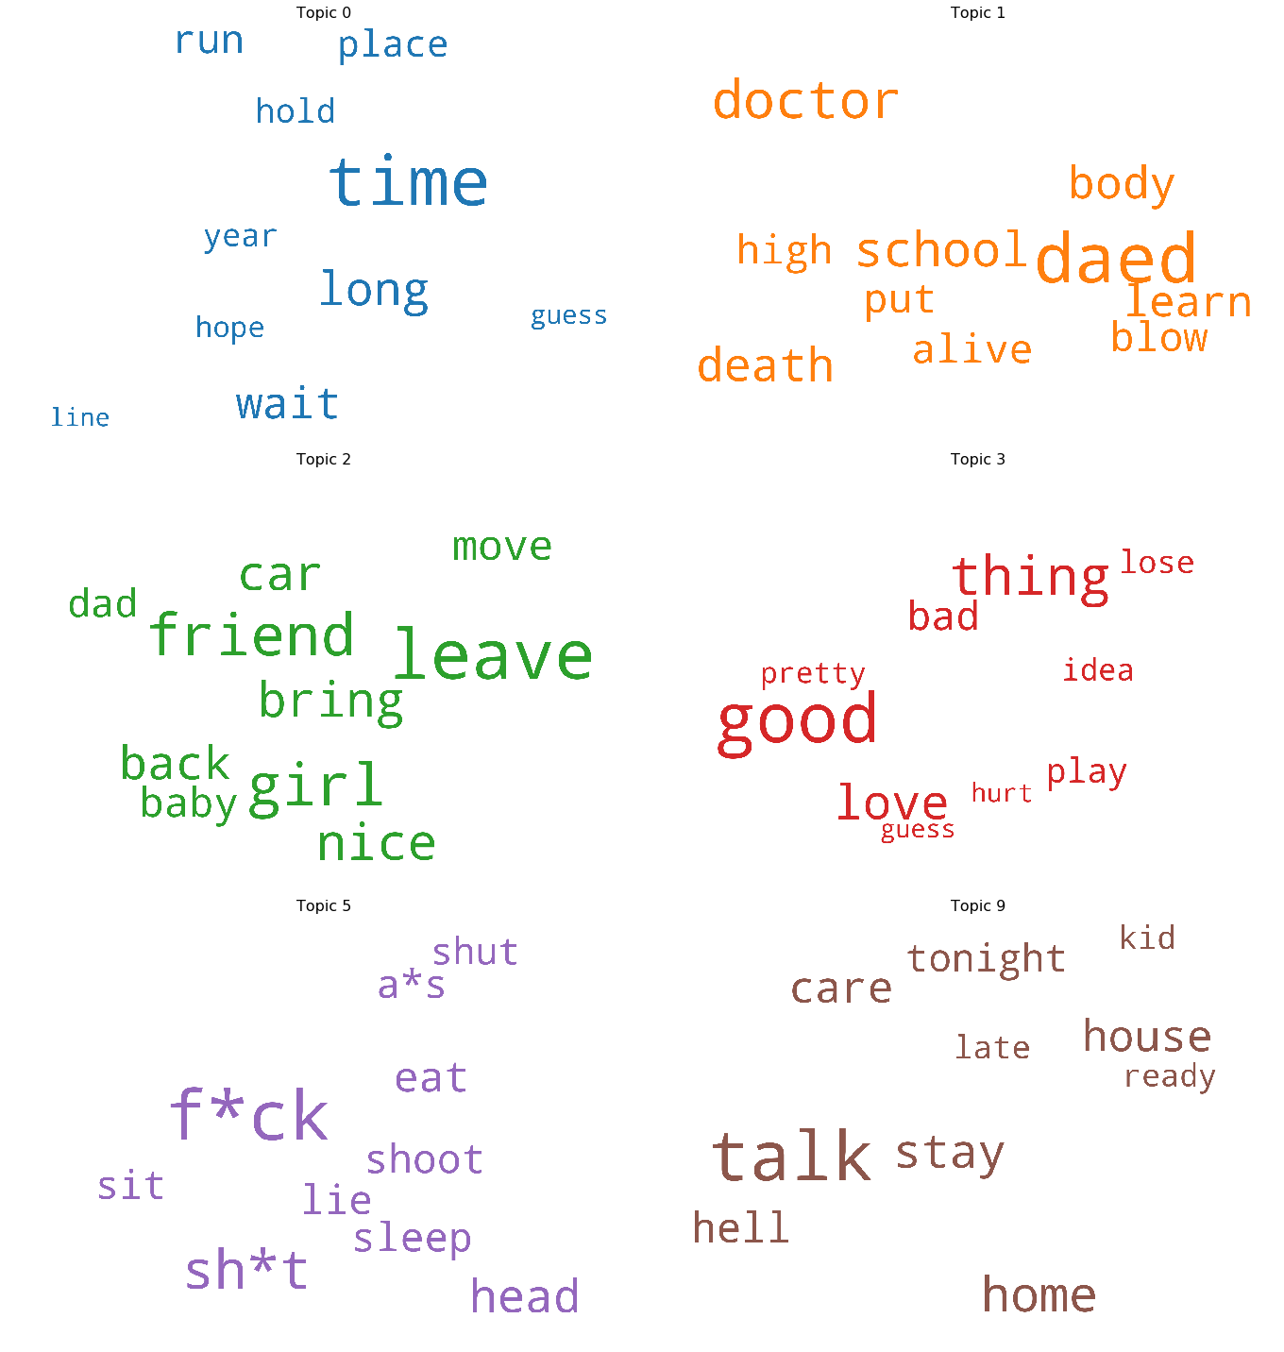
Results
Overall topics distribution:
Notes:
Describe our hypothesis briefly.

Slide 14
Results
Overall topics distribution:
Group | First topic | Second topic | Third | Fourth topic
Overall | Topic 0 (Time) | Topic 2 (Friend) | Topic 3 (good) | Topic 1 (dead)
Female to Female | Topic 0 (Time) | Topic 2 (Friend) | Topic 3 (good) | Topic 9 (talk)
Male to Male | Topic 0 (Time) | Topic 5 (Swear) | Topic 1 (dead) | Topic 3 (good)
Crossgender | Topic 0 (Time) | Topic 2 (Friend) | Topic 3 (good) | Topic 9 (talk)
Notes:
Female dialogues and cross gender dialogues have a similar distribution and focus on Family, Love and Health.
Male dialogues included similar topics (Love and health), and a swear topic.
The second most dominant for the general dataset is 1 and then 2 and then 5. Which represents usual daily interactions. The F-M conversations also shared the same topic order.

Slide 15
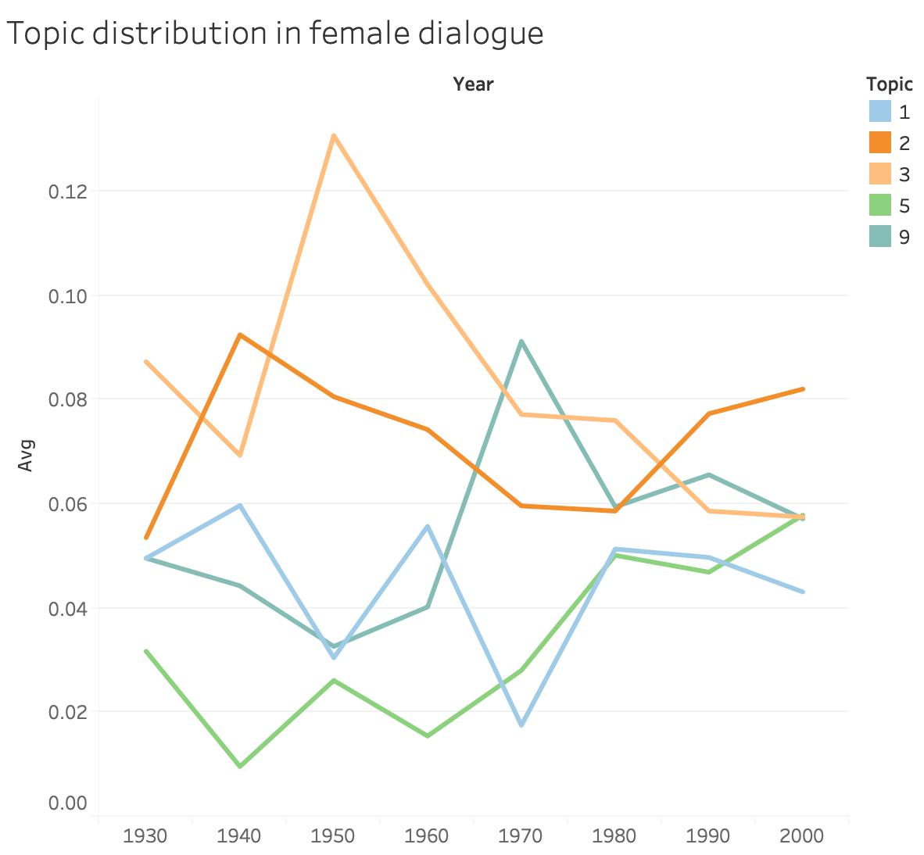
Results
Notes:
Describe our hypothesis briefly.

Slide 16
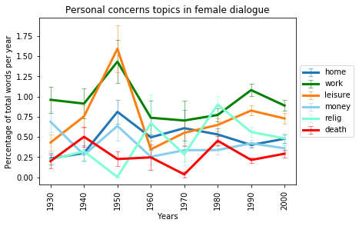
Results
Notes:
Describe our hypothesis briefly.

Slide 17
Discussion
Female topics aligns mostly with the overall topics.
The topics changed with time and they are more balanced in recent years.
Notes:
Describe our hypothesis briefly.
What is interesting is that m-m conversations and the f-f conversations had different topics distributions.
This result is more representative of newer movies as the data is skewed towards later years.
We find that male references in the female-female conversation dominates the topics of women conversations more than 77% of the time across the years.
This includes mentioning men in the context of other topics.
In genre analysis, we can see that the conversations in some genres contain more male references than others.
The general topics distribution overall dialogues changed with time, which might have influenced the topic distribution of the model.
In general all of the dialogues share the same dominant topic (0).

Slide 18
Hypo 2. Female characters have a more powerful appearance in specific genres.
Discuss appearance in two aspects:
Length of dialogue
Role in conversation
Notes:
Our second hypothesis is female characters have more powerful appearance in specific genres, like romance and drama.
Here we discuss appearance in two aspects: length of dialogue and role in conversation.

Slide 19
Hypo 2. Female characters have a more powerful appearance in specific genres.
2.1. Gender gap in dialogue length
Length: #lines (#words)
Ratio = #male lines / # total lines
Notes:
First, let’s look at the female and male dialogue length. We define the dialogue length as the number of lines. We also checked the definition as number of words and get similar result.

Slide 20
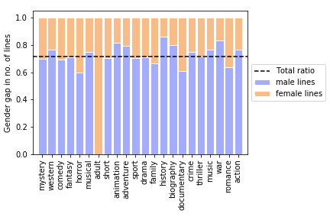
History - > his story?
Notes:
We checked the ratio of male lines to total lines and got following plot.
Male roles dominate movie dialogues in almost all genres, especially history. So history is really his story?
Female roles have more lines in horror and romance movies than average, but not in drama.
We would notice that there is an orange line represent all female lines, it’s adult. From previous genre distribution, we could see that adult only have one movie, so the result may not be general.

Slide 21
Hypo 2. Female characters have a more powerful appearance in specific genres.
2.2. Gender gap in conversation initiator vs responder
Initiator: the first character of a conversation
Responder: the second character of a conversation
Check female-female, female-male, male-female, male-male conversations
Take proportion in each genre, not counts
Notes:
Then we look at the conversation role. Here we differ the conversation role as initiator and responder.
Initiator is defined as the first character of a conversation and responder is the second character of a conversation.
We infer that the initiator may be the more dominant role in one conversation.
Here we check four types of conversation: ff, fm, mf, and mm.

Slide 22
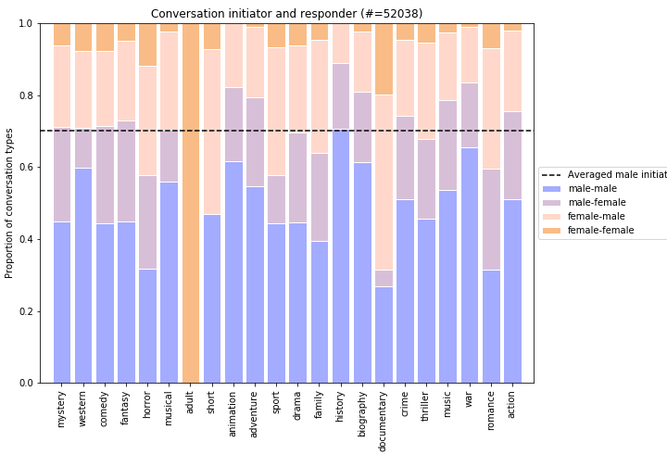
Notes:
Similar to the result of dialogue length,
male start (and respond to) most conversations
Female starts conversation more in adult, short and documentation, but may be outliers.
No female-female conversations in history, adventure, war and animation.

Slide 23
Hypo 3 Movies with higher rating tend to have a stronger male presence.
Female presence (of a movie) = # female lines / # total lines
Male presence = 1 - Female presence
Notes:
Our third hypothesis is about the relationship between movie rating and female presence.
Here we define female presence of a movie is the ratio of female dialogues to the total dialogues in that movie.

Slide 24
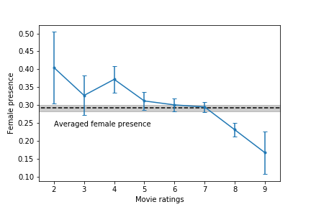
Notes:
Here is the plot. X-axis is movie ratings, y is the female presence at given movie ratings.
This plot suggests that hypo 3 is true. Highly rated movies do have stronger male presence.

Slide 25
Conclusions
Men are in most women conversations even if they weren’t the main topic.
Male references dominated the words of female character lines when they talk to each other.
No clear trend in the male references through the years.
Female dialogue topics change through time .
They are more balanced in recent years
Dialogue length:
Male roles dominate movie dialogues in almost all genres, especially history.
Female roles have more lines in horror and romance movies, but not in drama.
Notes:
Conclusion from Amal.
For almost all genres, male dominate movie dialogues and start most conversations,

Slide 26
Conclusions
4. Conversation initiator vs responder:
Male roles start most conversations.
Female starts conversation more in adult, short and documentation, but may be outliers.
No female-female conversations in history, adventure, war and animation.
5. Ratings:
Highly rated movies tend to have stronger male presence.
Notes:
Highly rated movies tend to have stronger male presence.

Slide 27
Future work
More and better data:
1) Collect more diverse movie dialogue corpus for analysis
2) Advanced labeling tech for gender
Definitions of leading roles (Eg., mentioned most frequently)
Notes:
We expect to have more and better data, more diverse on time and genre.
We could apply labeling tech for genders, like from text or IMDB, instead of using given labels.
We could also analyze the female leading roles in movies, defined as being mentioned most frequently, instead of having longest dialogue.

Slide 28
Thank you

Slide 29
Backup slides

Slide 30
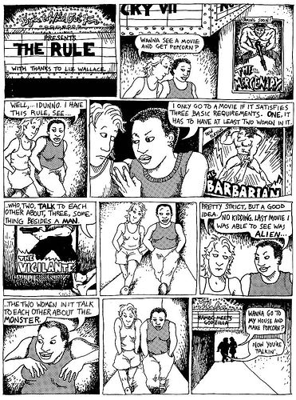
Bechdel Test

Slide 31
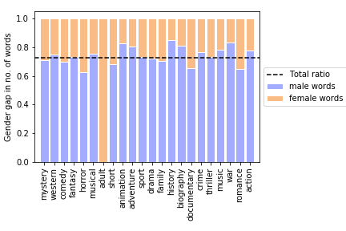
Hypo 2.2, use #words. Result similar to that using #lines.

Slide 32
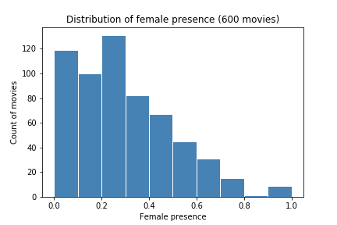

Slide 33
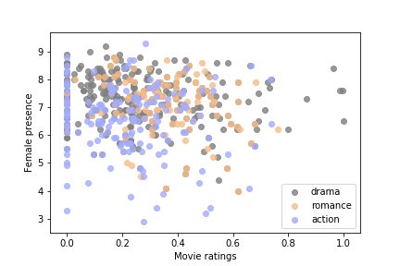
Notes:
Using three genres to show their different distribution of rating vs female presence: all have counts>50
Drama is the most dominant genre, spread across female presence, mainly in

Slide 34
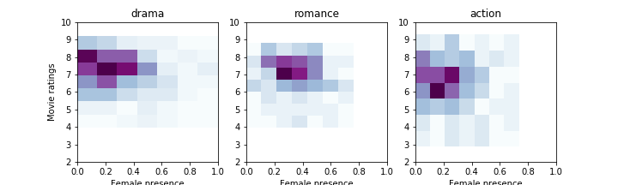
Notes:
Using three genres to show their different distribution of rating vs female presence: all have counts>50
Drama is the most dominant genre, spread across female presence, mainly in

Slide 35
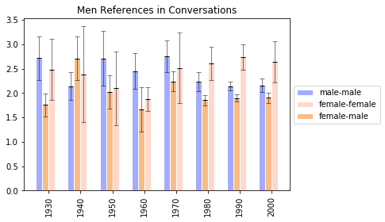
Notes:
This is the average of men references in dialogue with comparison to year and different parties involved in it

Slide 36
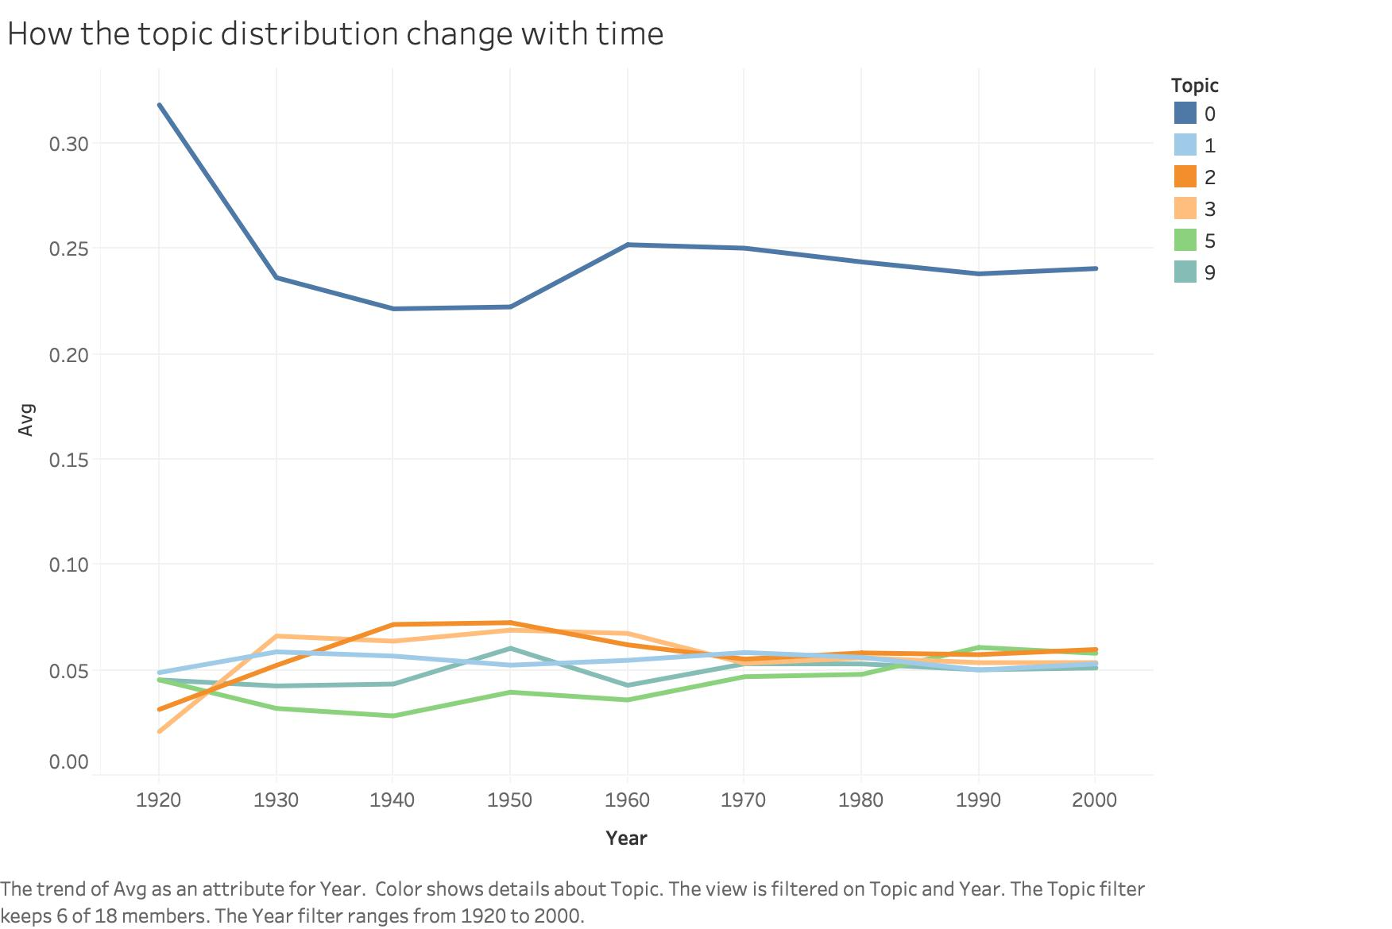
Notes:
LDA result on all movies with those 6 most dominant topics

Slide 37
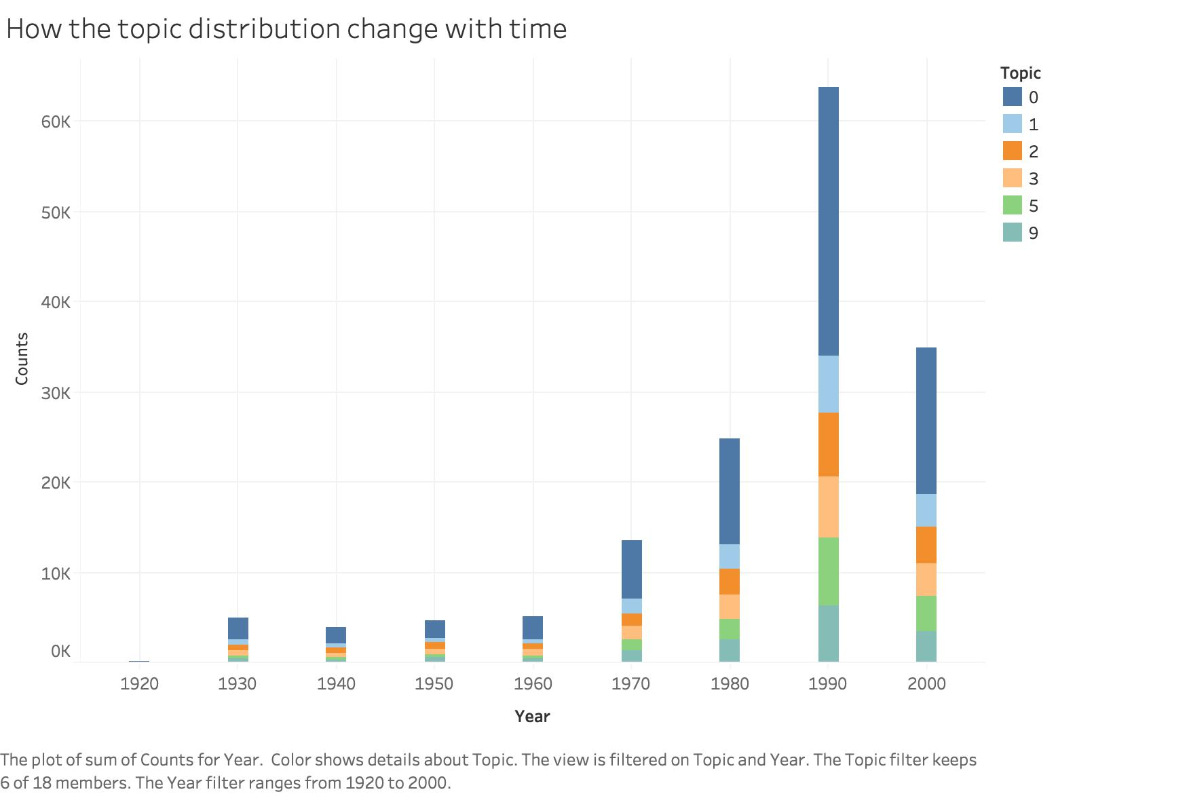
Notes:
LDA result on all movies with those 6 most dominant topics (without 0)

Slide 38
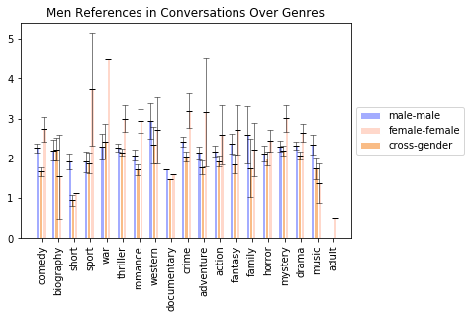
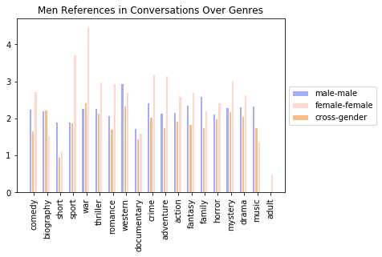
Notes:
This is the average of men references in dialogue with comparison to year and different parties involved in it

Slide 39
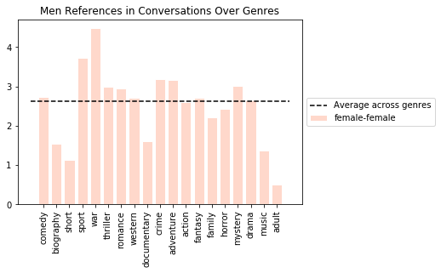
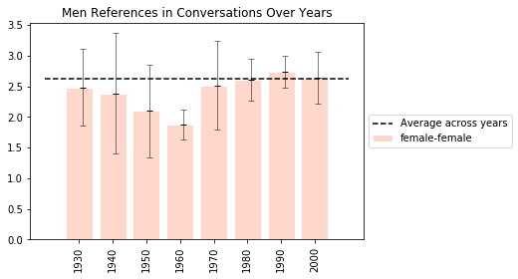
Notes:
Slides to support hypothesis 1,

Slide 43
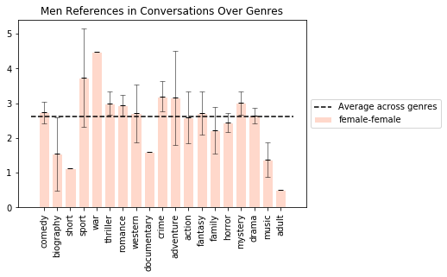
Results
Notes:
The ratio of men references differed between genres. Clearly in Music and war.

